Slide 1
Fine-Grained Hallucination Detection and Severity-Aware Mitigation in Vision-Language Models
Abdulaziz Alqahtani & Alwaleed Alharthi | Supervisor: Dr. Muzammil Behzad

Slide 2
Introduction
LVLMs (e.g., LLaVA-style models) handle image-grounded QA and description with strong fluency.
They still hallucinate visual content not supported by the image.
Errors span objects, attributes, relationships, counts, and scene details.
Severity ranges from minor wording slips to serious factual mismatches.
This reduces reliability and trust in real applications such as accessibility, medical, and robotics.

Slide 3
Motivation & Research Gap
Most prior work treats hallucination as a coarse binary problem.
Binary labels do not explain what is wrong or how severe the error is.
Preference-based alignment (DPO) depends on reliable chosen / rejected pairs.
Auto-generated preference pairs are often noisy without external validation.
Gap: combine fine-grained critiques, severity scores, and preference validation in one pipeline.

Slide 4
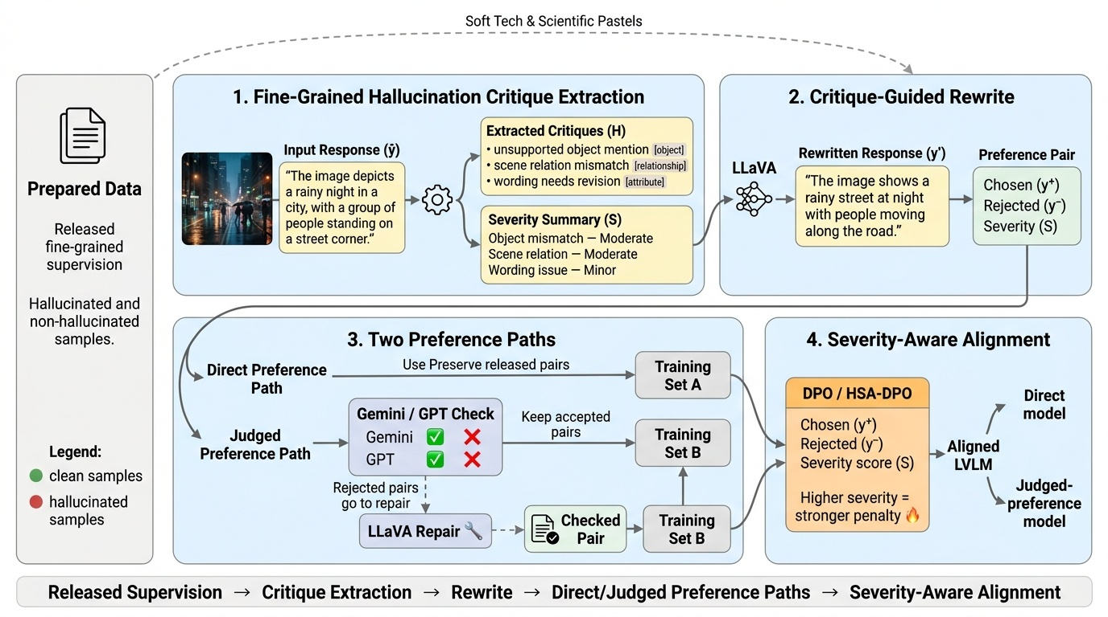
Methodology

Slide 5
Compared Preference Training Variants
Variant | Preference Data | Severity Use
Standard DPO | Uses chosen/rejected response pairs directly | Does not use severity scores
Direct HSA-DPO | Uses released/prepared preference pairs directly | Uses severity to penalize severe hallucinations more strongly
Judged Severity-Margin HSA-DPO | Preference pairs are first checked by Gemini/GPT-style judges; weak pairs are repaired or removed | Uses severity as a margin, requiring stronger preference separation for severe hallucinations

Slide 6
Experiment Setup
Models
Base: LLaVA-1.5-7B | Variants: standard DPO, direct HSA-DPO, judged severity-margin HSA-DPO
Data
16,143 normalized records (7,643 hallucinated, 8,500 clean) → 8,386 image-response preference pairs
Training
1 epoch · per-device BS 1 · effective BS 32 · LR 2e-6 · DPO β 0.1 · LoRA rank 128, α 256 · max seq len 1024
Benchmarks
POPE · Object HalBench · AMBER

Slide 7
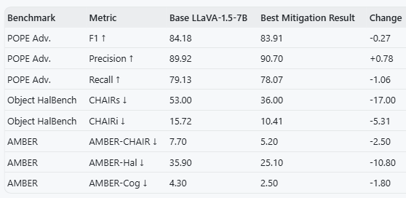
Results & Conclusion

Slide 8
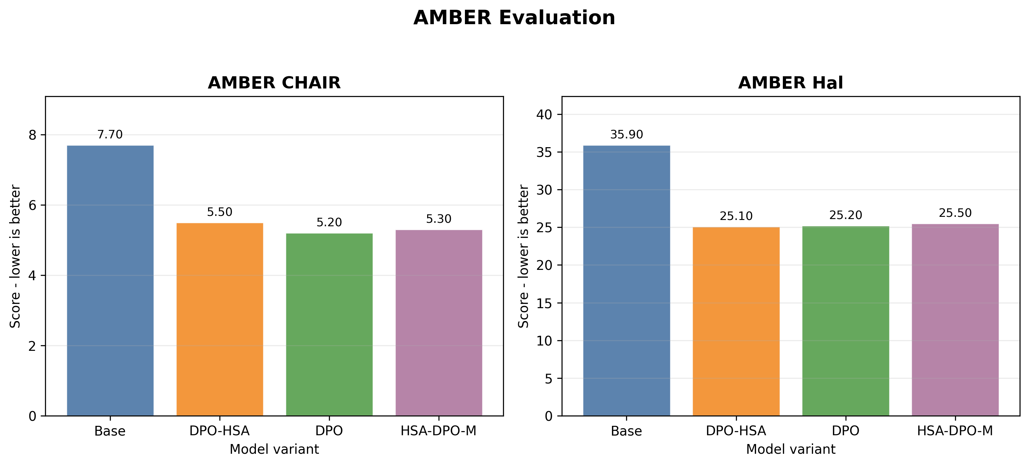
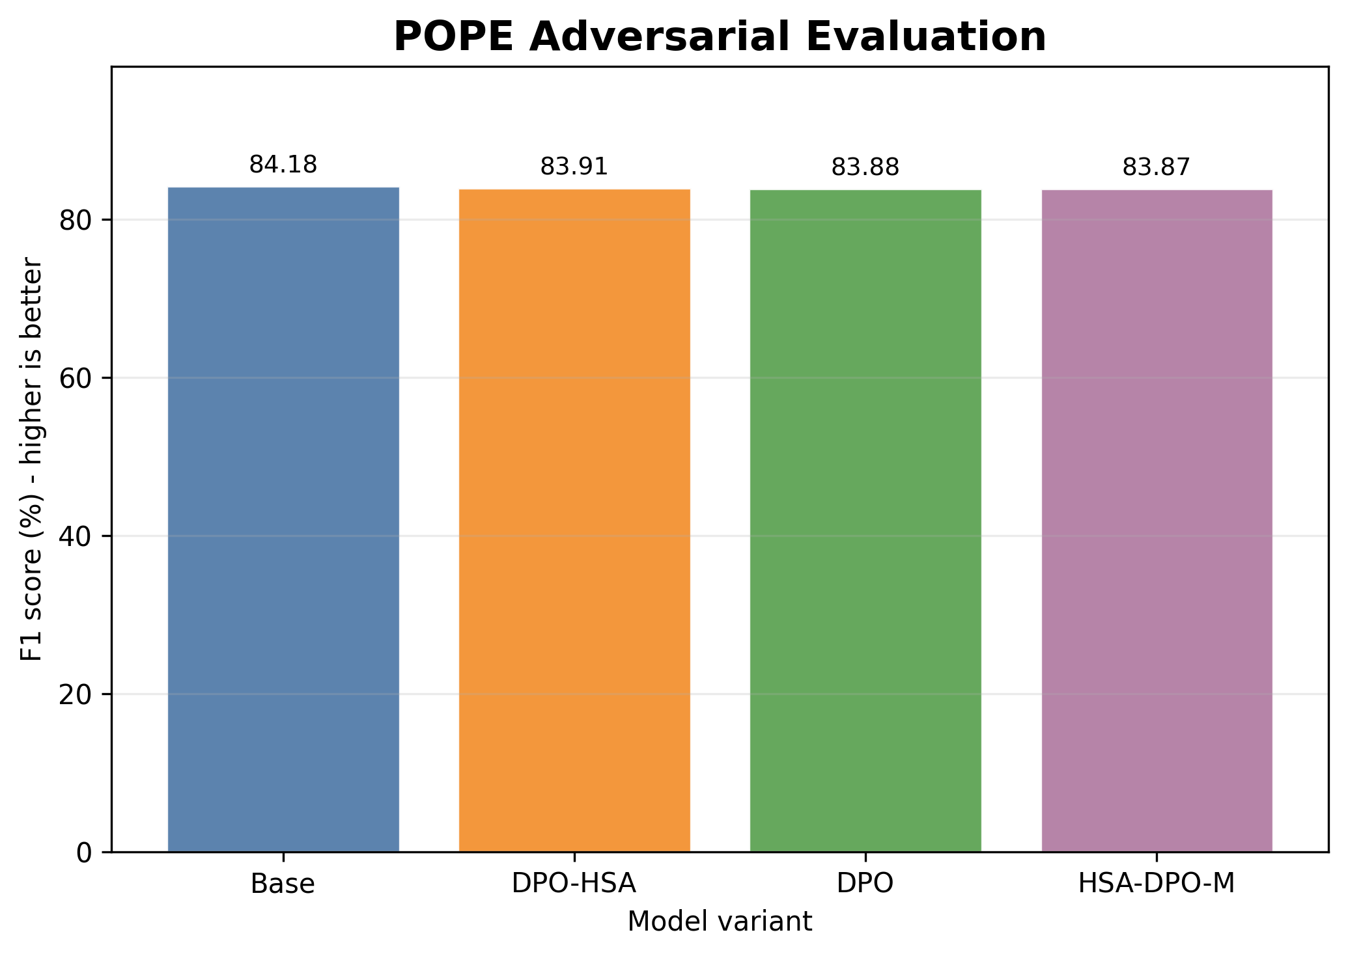
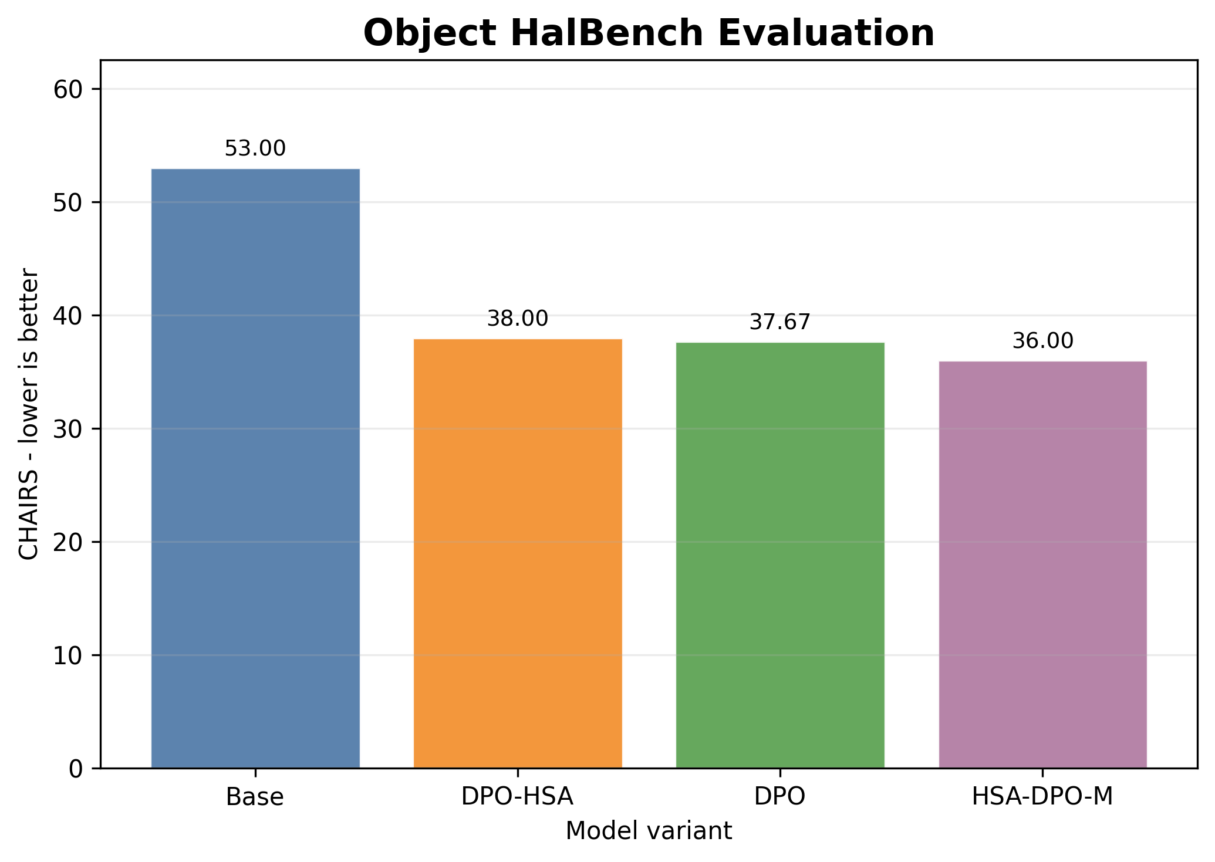

Slide 9
Discussion and Conclusion
Fine-grained critiques identify hallucination type and severity.
Severity-aware training reduces some hallucination metrics.
POPE shows no clear improvement.
Object HalBench and AMBER improve.
Results are useful but not universal.
Better preference quality may improve future results.

